Slide 1
"Object Detection with Python“ Using OpenCV & YOLO (Step By Step Tutorial) Pravin Varak

Slide 2
Introduction to Object Detection
“Object detection is a computer vision technique used to identify and locate objects within images or videos. It involves two primary tasks: localizing objects within an image (drawing bounding boxes around them) and classifying the type of objects present.”

Slide 3
Object Detection Applications
Autonomous Vehicles: Object detection is crucial for vehicles to recognize pedestrians, other vehicles, traffic signs, and obstacles on the road for safe navigation.
Surveillance and Security: Identifying people, intruders, or suspicious activities in surveillance footage helps enhance security.
Retail: Retailers use object detection for inventory management, tracking products on shelves, and analysing customer behaviour in stores.
Medical Imaging: Object detection assists in analysing medical images, locating anomalies, tumours, or other medical conditions.
Augmented Reality: Recognizing and tracking objects in real-time facilitates AR applications, enhancing user experiences.
Industrial Automation: Object detection is used in quality control, robotics, and monitoring production lines.
"Object detection continues to evolve, with ongoing research focusing on improving accuracy, speed, and applicability across various domains."

Slide 4
List of Prerequisites
Python basics
Required libraries (OpenCV, NumPy, MatPlotlib.Pyplot)
Installation commands (pip install opencv-python numpy)

Slide 5
Programming Environment
To set the Programming environment we have to choose An Integrated Development Environment (IDE).
IDE is a comprehensive software application that consolidates various tools essential for software development into a single integrated platform. It aims to enhance the efficiency and productivity of developers by providing a unified environment for writing, testing, and debugging code.
To name few popular IDE; Visual Studio Code, Spyder, Jupiter Note Book, PyCharm, Atom, Eclipse etc.
Most popular IDE used for Object Detection is Google Colab is a cloud-based platform provided by Google that offers free access to GPU and TPU resources.
I have used Spyder IDE.
We also need to download YOLO weights and configuration file from the official YOLO website:
https://pjreddie.com/darknet/yolo/

Slide 6
Code for Object Detection

Slide 7
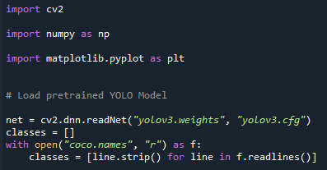
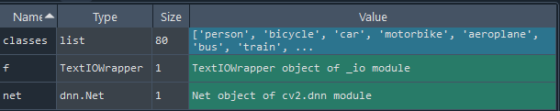
1. Code snippet for importing libraries & loading YOLO model
import cv2
import numpy as np
import matplotlib.pyplot as plt
# Load pretrained YOLO Model
net = cv2.dnn.readNet("yolov3.weights", "yolov3.cfg")
classes = []
with open("coco.names", "r") as f:
classes = [line.strip() for line in f.readlines()]

Slide 8

2. Code Snippet for Output Layers of the YOLO Network
"This section gets the output layers of the YOLO network. YOLO has some output
layers that give predictions at different scales. This code retrieves those
output layers."
layer_names = net.getUnconnectedOutLayersNames()

Slide 9
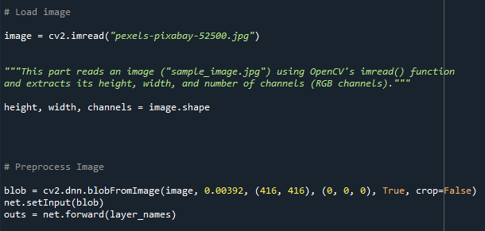
3. Code snippet for loading and pre-processing an image
# Load image
image = cv2.imread("pexels-pixabay-52500.jpg")
height, width, channels = image.shape
# Preprocess Image
blob = cv2.dnn.blobFromImage(image, 0.00392, (416, 416), (0, 0, 0), True, crop=False)
net.setInput(blob)
outs = net.forward(layer_names)

Slide 10
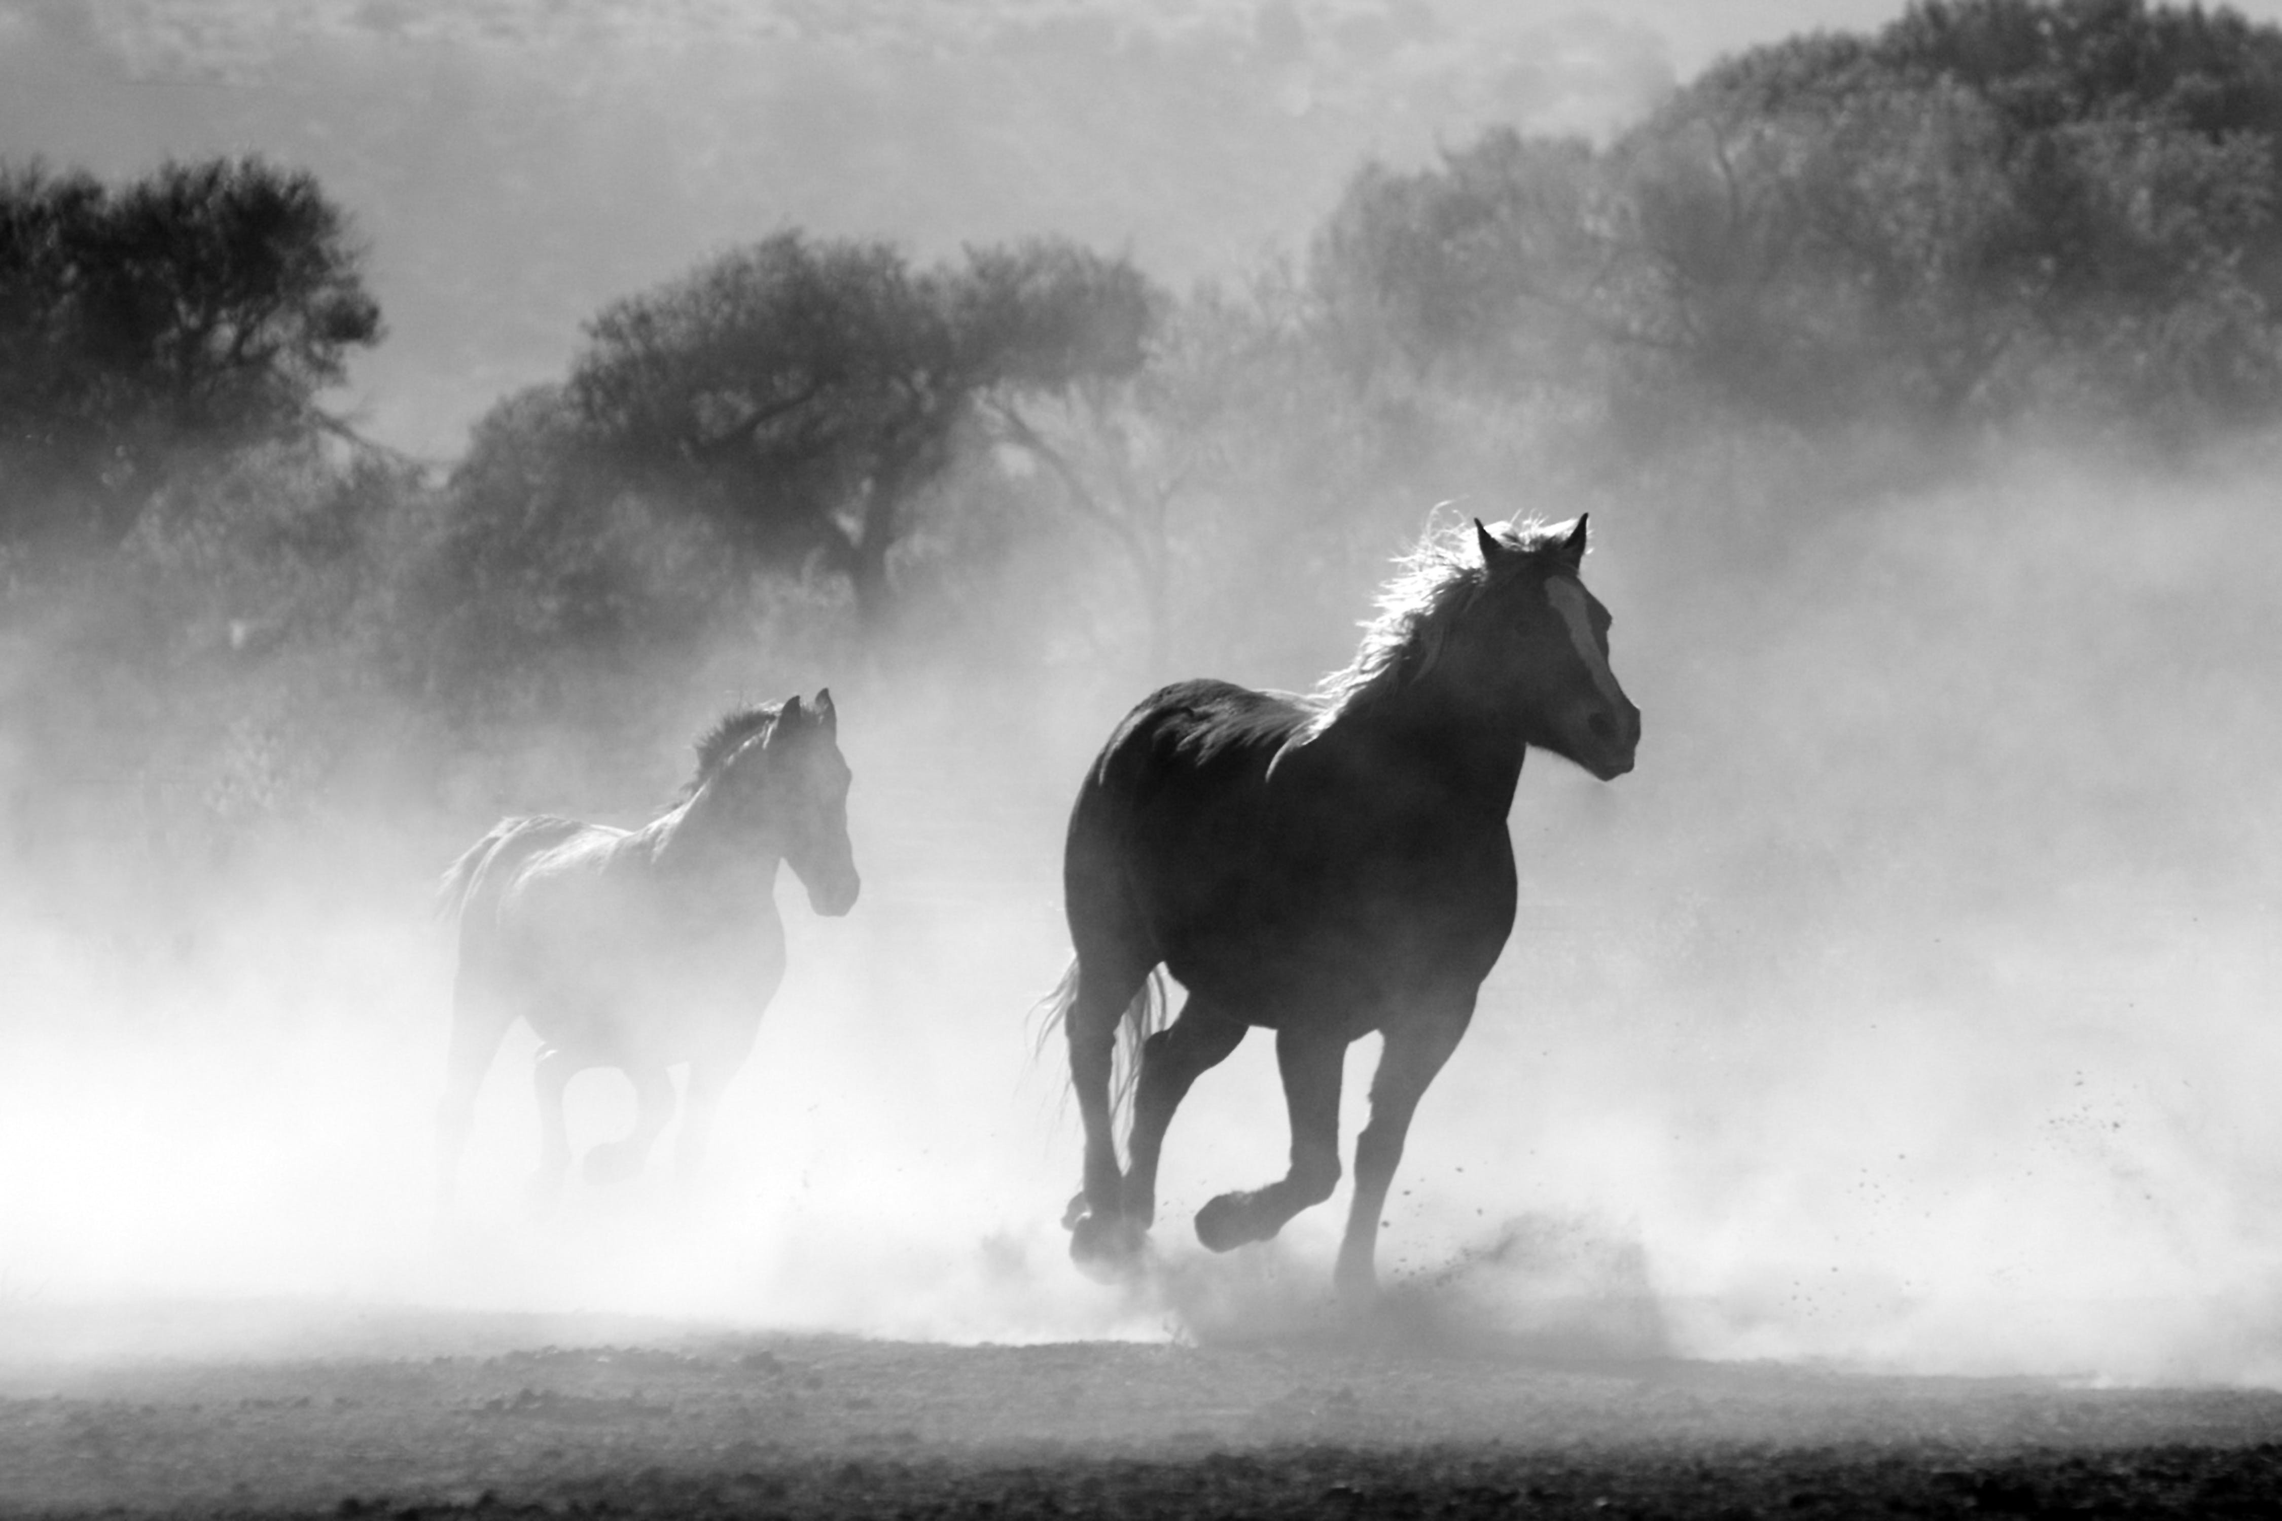
Input Image

Slide 11
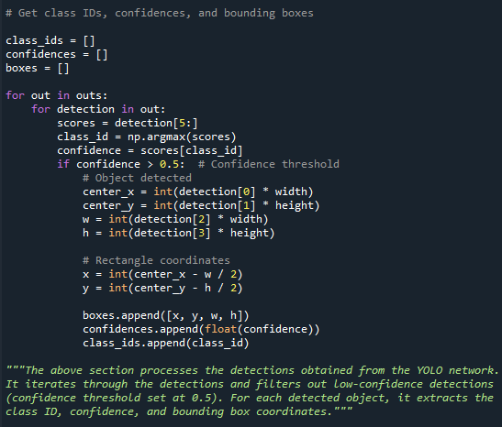
4. Code snippet for extracting class IDs, confidences, and bounding boxes
# Get class IDs, confidences, and bounding boxes
class_ids = []
confidences = []
boxes = []
#Code continues on next slide…..

Slide 12
for out in outs:
for detection in out:
scores = detection[5:]
class_id = np.argmax(scores)
confidence = scores[class_id]
if confidence > 0.5: # Confidence threshold
# Object detected
center_x = int(detection[0] * width)
center_y = int(detection[1] * height)
w = int(detection[2] * width)
h = int(detection[3] * height)
# Rectangle coordinates
x = int(center_x - w / 2)
y = int(center_y - h / 2)
boxes.append([x, y, w, h])
confidences.append(float(confidence))
class_ids.append(class_id)

Slide 13
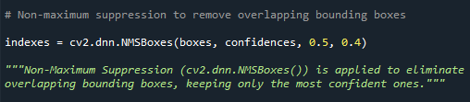
5. Code snippet for non-maximum suppression
indexes = cv2.dnn.NMSBoxes(boxes, confidences, 0.5, 0.4)
"""Non-Maximum Suppression (cv2.dnn.NMSBoxes()) is applied to eliminate overlapping bounding boxes, keeping only the most confident ones."""

Slide 14
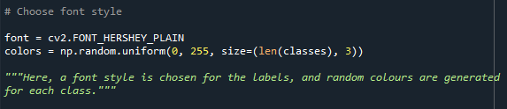
6. Code snippet for Font Style
# Choose font style
font = cv2.FONT_HERSHEY_PLAIN
colors = np.random.uniform(0, 255, size=(len(classes), 3))
"""Here, a font style is chosen for the labels, and random colours are generated for each class."""

Slide 15
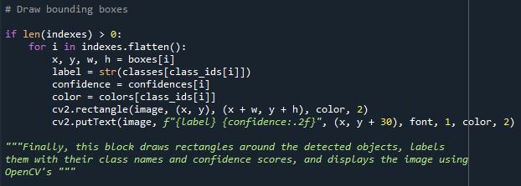
7. Code snippet for To Draw bounding boxes
if len(indexes) > 0:
for i in indexes.flatten():
x, y, w, h = boxes[i]
label = str(classes[class_ids[i]])
confidence = confidences[i]
color = colors[class_ids[i]]
cv2.rectangle(image, (x, y), (x + w, y + h), color, 2)
cv2.putText(image, f"{label} {confidence:.2f}", (x, y + 30), font, 1, color, 2)

Slide 16
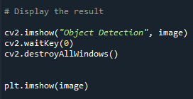
8. Code snippet for displaying the result
# Display the result
cv2.imshow("Object Detection", image)
cv2.waitKey(0)
cv2.destroyAllWindows()
plt.imshow(image)

Slide 17
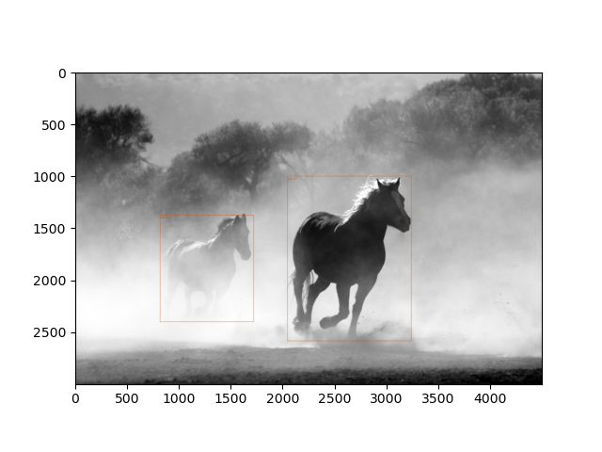
Output Image: We can see the boxes around horses with labels in top left corners.

Slide 18
Model Adjustment to Different Objects, Images or Videos
This pre-trained model will have to be adjusted to different objects, images or videos to recognize specific classes relevant to particular use case.
Annotate the image or video with bounding boxes around the objects of interest and label each bounding box with the corresponding class.
Open the YOLO configuration file (e.g., "yolov3.cfg") and modify the ‘classes’ parameter in the ‘[net]’ section to match the number of classes in our custom dataset.
Optionally, update the ‘anchors’ parameter based on the aspect ratios of objects in our dataset.
We also might need to update our class labels file.
We can also fine tune our model if we have large & diverse data set.

Slide 19
Conclusion
This script reads an image, detects objects using the YOLO model, and displays the result with bounding boxes and labels.

Slide 20
Potential Next Steps
This model with slight modification can be used for various other images, video inputs & real time web cam detection.

